Slide 1


Machine Learning 8. Neural Networks
Xueyuan Gong
School of Intelligent Systems Science and Engineering

Slide 2
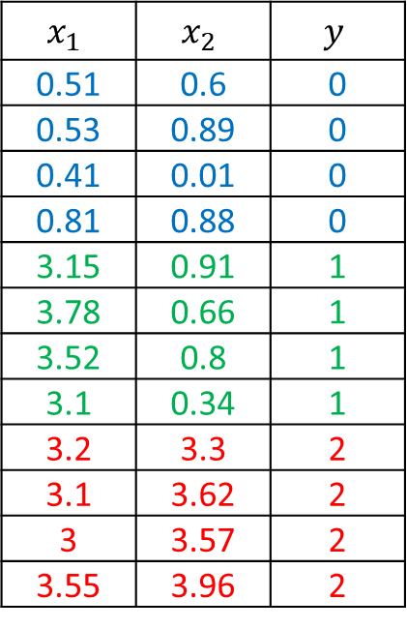
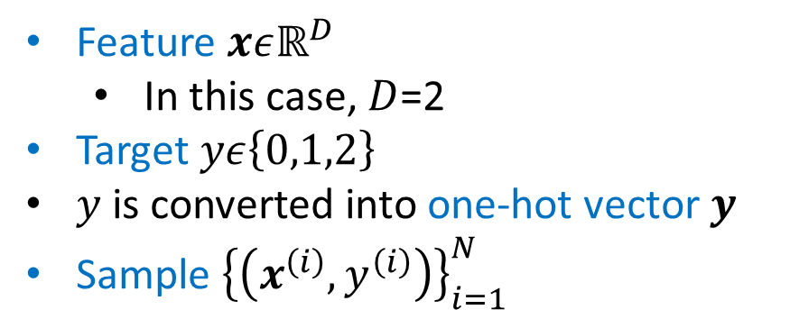
Multi-class classification
Dataset
Feature $xεℝ^{D}$
In this case, $D$=2
Target $yε\left\{0,1,2\right\}$
$y$ is converted into one-hot vector $y$
Sample ${\left\{\left(x^{\left(i\right)},y^{\left(i\right)}\right)\right\}}_{i=1}^{N}$
$$x_{1}$$ | $$x_{2}$$ | $$y$$
0.51 | 0.6 | 0
0.53 | 0.89 | 0
0.41 | 0.01 | 0
0.81 | 0.88 | 0
3.15 | 0.91 | 1
3.78 | 0.66 | 1
3.52 | 0.8 | 1
3.1 | 0.34 | 1
3.2 | 3.3 | 2
3.1 | 3.62 | 2
3 | 3.57 | 2
3.55 | 3.96 | 2

Slide 3


















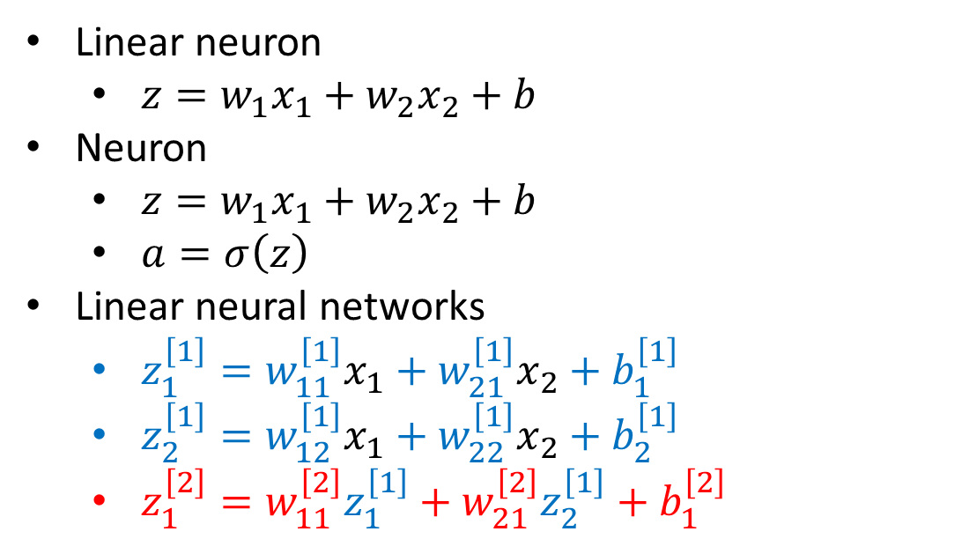


Neuron
$$1$$
$$b$$
$$x_{1}$$
$$w_{1}$$
$$z$$
$$w_{2}$$
$$x_{2}$$
Linear neuron
$z=w_{1}x_{1}+w_{2}x_{2}+b$
Neuron
$z=w_{1}x_{1}+w_{2}x_{2}+b$
$a=σ\left(z\right)$
Linear neural networks
$z_{1}^{\left[1\right]}=w_{11}^{\left[1\right]}x_{1}+w_{21}^{\left[1\right]}x_{2}+b_{1}^{\left[1\right]}$
$z_{2}^{\left[1\right]}=w_{12}^{\left[1\right]}x_{1}+w_{22}^{\left[1\right]}x_{2}+b_{2}^{\left[1\right]}$
$z_{1}^{\left[2\right]}=w_{11}^{\left[2\right]}z_{1}^{\left[1\right]}+w_{21}^{\left[2\right]}z_{2}^{\left[1\right]}+b_{1}^{\left[2\right]}$
$$1$$
$$b$$
$$x_{1}$$
$$w_{1}$$
$$z$$
$$a$$
$$w_{2}$$
$$x_{2}$$
$$x_{1}$$
$$z_{1}^{\left[1\right]}$$
$$z_{1}^{\left[2\right]}$$
$$x_{2}$$
$$z_{2}^{\left[1\right]}$$
Do they look similar to you?
Simplify the figure for convenience

Slide 4


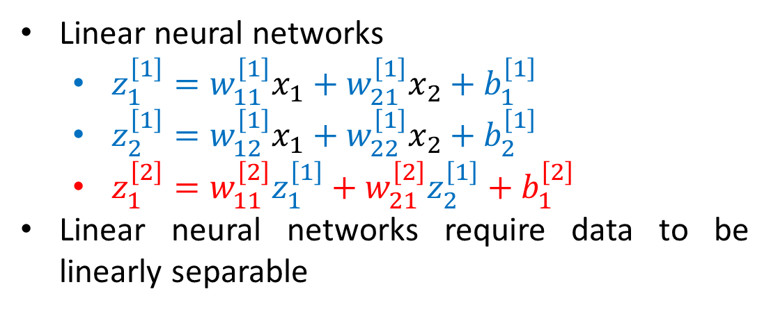



Linear Neural Networks
Linear neural networks
$z_{1}^{\left[1\right]}=w_{11}^{\left[1\right]}x_{1}+w_{21}^{\left[1\right]}x_{2}+b_{1}^{\left[1\right]}$
$z_{2}^{\left[1\right]}=w_{12}^{\left[1\right]}x_{1}+w_{22}^{\left[1\right]}x_{2}+b_{2}^{\left[1\right]}$
$z_{1}^{\left[2\right]}=w_{11}^{\left[2\right]}z_{1}^{\left[1\right]}+w_{21}^{\left[2\right]}z_{2}^{\left[1\right]}+b_{1}^{\left[2\right]}$
Linear neural networks require data to be linearly separable
$$x_{1}$$
$$z_{1}^{\left[1\right]}$$
$$z_{1}^{\left[2\right]}$$
$$x_{2}$$
$$z_{2}^{\left[1\right]}$$
$$z_{1}^{\left[2\right]}=w_{11}^{\left[2\right]}\left(w_{11}^{\left[1\right]}x_{1}+w_{21}^{\left[1\right]}x_{2}+b_{1}^{\left[1\right]}\right)+w_{21}^{\left[2\right]}\left(w_{12}^{\left[1\right]}x_{1}+w_{22}^{\left[1\right]}x_{2}+b_{2}^{\left[1\right]}\right)+b_{1}^{\left[2\right]}=\left(w_{11}^{\left[2\right]}w_{11}^{\left[1\right]}+w_{21}^{\left[2\right]}w_{12}^{\left[1\right]}\right)x_{1}+\left(w_{11}^{\left[2\right]}w_{21}^{\left[1\right]}+w_{21}^{\left[2\right]}w_{22}^{\left[1\right]}\right)x_{2}+\left(w_{11}^{\left[2\right]}b_{1}^{\left[1\right]}+w_{21}^{\left[2\right]}b_{2}^{\left[1\right]}+b_{1}^{\left[2\right]}\right)$$
This is still a linear function

Slide 5

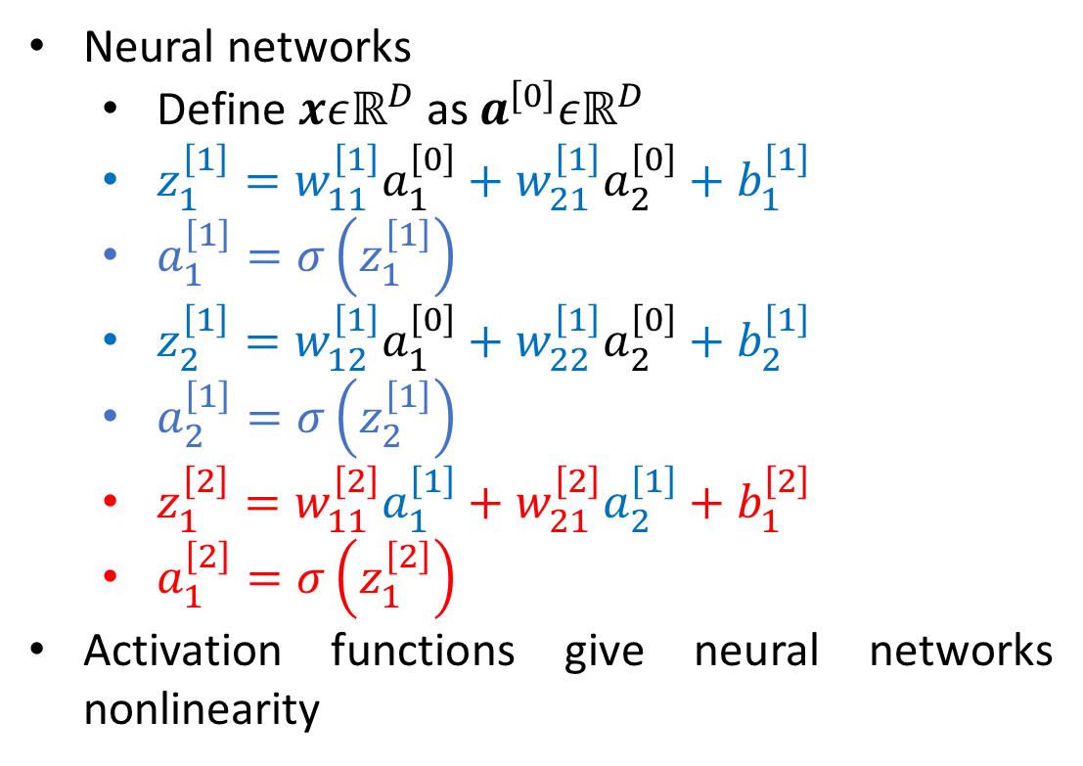







Neural Networks
Neural networks
Define $xεℝ^{D}$ as $a^{\left[0\right]}εℝ^{D}$
$z_{1}^{\left[1\right]}=w_{11}^{\left[1\right]}a_{1}^{\left[0\right]}+w_{21}^{\left[1\right]}a_{2}^{\left[0\right]}+b_{1}^{\left[1\right]}$
$a_{1}^{\left[1\right]}=σ\left(z_{1}^{\left[1\right]}\right)$
$z_{2}^{\left[1\right]}=w_{12}^{\left[1\right]}a_{1}^{\left[0\right]}+w_{22}^{\left[1\right]}a_{2}^{\left[0\right]}+b_{2}^{\left[1\right]}$
$a_{2}^{\left[1\right]}=σ\left(z_{2}^{\left[1\right]}\right)$
$z_{1}^{\left[2\right]}=w_{11}^{\left[2\right]}a_{1}^{\left[1\right]}+w_{21}^{\left[2\right]}a_{2}^{\left[1\right]}+b_{1}^{\left[2\right]}$
$a_{1}^{\left[2\right]}=σ\left(z_{1}^{\left[2\right]}\right)$
Activation functions give neural networks nonlinearity
Input layer
Hidden layer
Output layer
$$a_{1}^{\left[0\right]}$$
$$z_{1}^{\left[1\right]}$$
$$a_{1}^{\left[1\right]}$$
$$z_{1}^{\left[2\right]}$$
$$a_{1}^{\left[2\right]}$$
$$a_{2}^{\left[0\right]}$$
$$z_{2}^{\left[1\right]}$$
$$a_{2}^{\left[1\right]}$$

Slide 6
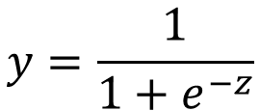



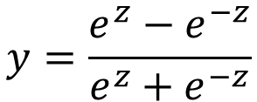
Activation Functions
Identity
Sigmoid
Tanh
(Hyperbolic Tangent)
ReLU
(Rectified Linear Unit)
Soft ReLU
$$y=\frac{1}{1+e^{−z}}$$
$$y=\frac{e^{z}−e^{−z}}{e^{z}+e^{−z}}$$
$$y=z$$
$$y=\max\left(0,z\right)$$
$$y=\log\left(1+e^{z}\right)$$

Slide 7
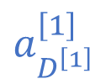



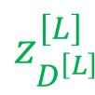
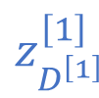



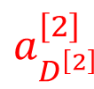

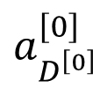



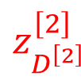






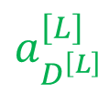
Fully Connected Neural Networks
$$a_{1}^{\left[0\right]}$$
$$z_{1}^{\left[1\right]}$$
$$a_{1}^{\left[1\right]}$$
$$z_{1}^{\left[2\right]}$$
$$a_{1}^{\left[2\right]}$$
…
$$z_{1}^{\left[L\right]}$$
$$a_{1}^{\left[L\right]}$$
$$a_{2}^{\left[0\right]}$$
$$z_{2}^{\left[1\right]}$$
$$a_{2}^{\left[1\right]}$$
$$z_{2}^{\left[2\right]}$$
$$a_{2}^{\left[2\right]}$$
…
$$z_{2}^{\left[L\right]}$$
$$a_{2}^{\left[L\right]}$$
…
…
…
…
…
$$a_{D^{\left[0\right]}}^{\left[0\right]}$$
$$z_{D^{\left[1\right]}}^{\left[1\right]}$$
$$a_{D^{\left[1\right]}}^{\left[1\right]}$$
$$z_{D^{\left[2\right]}}^{\left[2\right]}$$
$$a_{D^{\left[2\right]}}^{\left[2\right]}$$
…
$$z_{D^{\left[L\right]}}^{\left[L\right]}$$
$$a_{D^{\left[L\right]}}^{\left[L\right]}$$
There are $L$ layers in total
Each layer has $D^{\left[l\right]}$ neurons
The last layer (layer $L$) is always slightly different from the other layers

Slide 8
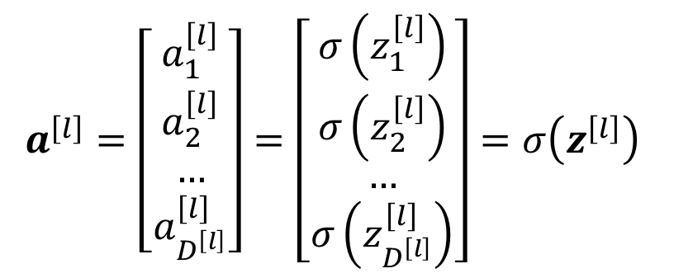
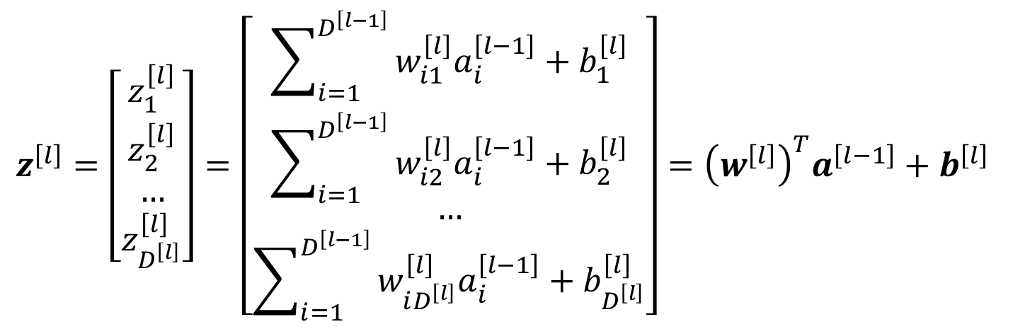
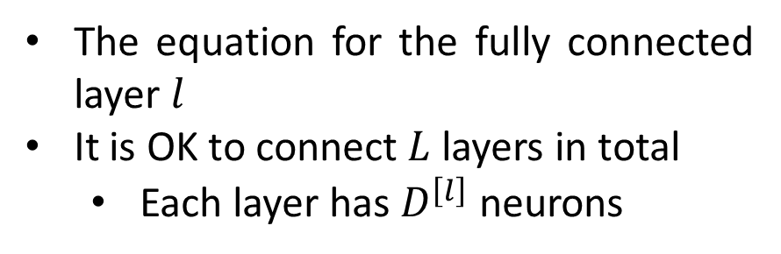
Fully Connected Layer
$$z^{\left[l\right]}=\left[\begin{matrix}z_{1}^{\left[l\right]} \\ z_{2}^{\left[l\right]} \\ … \\ z_{D^{\left[l\right]}}^{\left[l\right]}\end{matrix}\right]=\left[\begin{matrix}\sum_{i=1}^{D^{\left[l−1\right]}}{w_{i1}^{\left[l\right]}a_{i}^{\left[l−1\right]}+b_{1}^{\left[l\right]}} \\ \sum_{i=1}^{D^{\left[l−1\right]}}{w_{i2}^{\left[l\right]}a_{i}^{\left[l−1\right]}+b_{2}^{\left[l\right]}} \\ … \\ \sum_{i=1}^{D^{\left[l−1\right]}}{w_{iD^{\left[l\right]}}^{\left[l\right]}a_{i}^{\left[l−1\right]}+b_{D^{\left[l\right]}}^{\left[l\right]}}\end{matrix}\right]={\left(w^{\left[l\right]}\right)}^{T}a^{\left[l−1\right]}+b^{\left[l\right]}$$
$$a^{\left[l\right]}=\left[\begin{matrix}a_{1}^{\left[l\right]} \\ a_{2}^{\left[l\right]} \\ … \\ a_{D^{\left[l\right]}}^{\left[l\right]}\end{matrix}\right]=\left[\begin{matrix}σ\left(z_{1}^{\left[l\right]}\right) \\ σ\left(z_{2}^{\left[l\right]}\right) \\ … \\ σ\left(z_{D^{\left[l\right]}}^{\left[l\right]}\right)\end{matrix}\right]=σ\left(z^{\left[l\right]}\right)$$
The equation for the fully connected layer $l$
It is OK to connect $L$ layers in total
Each layer has $D^{\left[l\right]}$ neurons

Slide 9
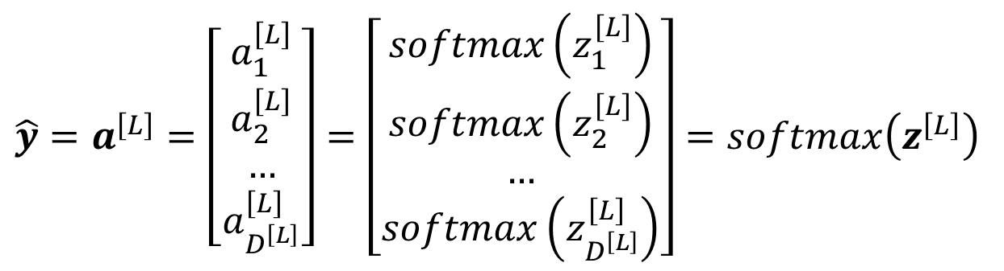
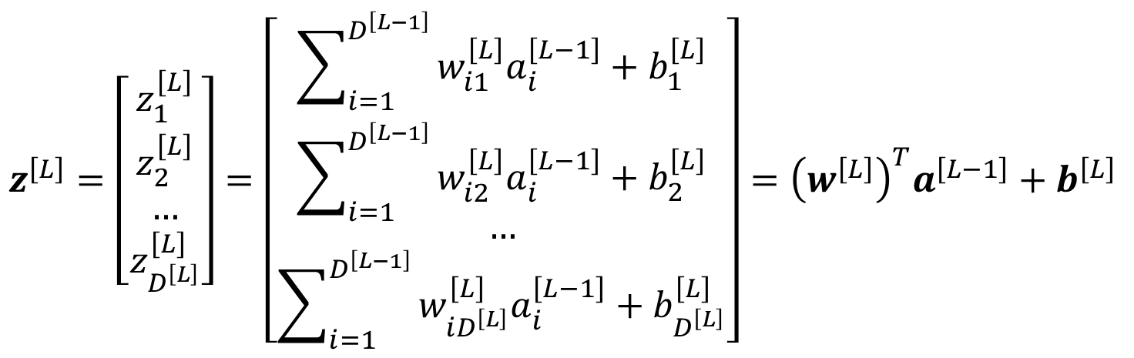
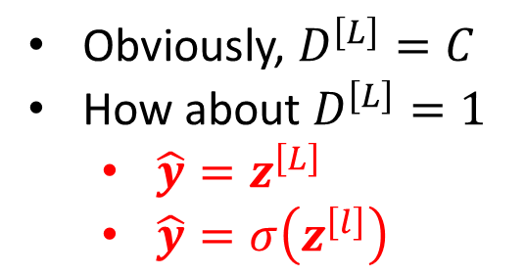
Output Layer
$$z^{\left[L\right]}=\left[\begin{matrix}z_{1}^{\left[L\right]} \\ z_{2}^{\left[L\right]} \\ … \\ z_{D^{\left[L\right]}}^{\left[L\right]}\end{matrix}\right]=\left[\begin{matrix}\sum_{i=1}^{D^{\left[L−1\right]}}{w_{i1}^{\left[L\right]}a_{i}^{\left[L−1\right]}+b_{1}^{\left[L\right]}} \\ \sum_{i=1}^{D^{\left[L−1\right]}}{w_{i2}^{\left[L\right]}a_{i}^{\left[L−1\right]}+b_{2}^{\left[L\right]}} \\ … \\ \sum_{i=1}^{D^{\left[L−1\right]}}{w_{iD^{\left[L\right]}}^{\left[L\right]}a_{i}^{\left[L−1\right]}+b_{D^{\left[L\right]}}^{\left[L\right]}}\end{matrix}\right]={\left(w^{\left[L\right]}\right)}^{T}a^{\left[L−1\right]}+b^{\left[L\right]}$$
$$\hat{y}=a^{\left[L\right]}=\left[\begin{matrix}a_{1}^{\left[L\right]} \\ a_{2}^{\left[L\right]} \\ … \\ a_{D^{\left[L\right]}}^{\left[L\right]}\end{matrix}\right]=\left[\begin{matrix}softmax\left(z_{1}^{\left[L\right]}\right) \\ softmax\left(z_{2}^{\left[L\right]}\right) \\ … \\ softmax\left(z_{D^{\left[L\right]}}^{\left[L\right]}\right)\end{matrix}\right]=softmax\left(z^{\left[L\right]}\right)$$
Obviously, $D^{\left[L\right]}=C$
How about $D^{\left[L\right]}=1$
$\hat{y}=z^{\left[L\right]}$
$\hat{y}=σ\left(z^{\left[l\right]}\right)$

Slide 10
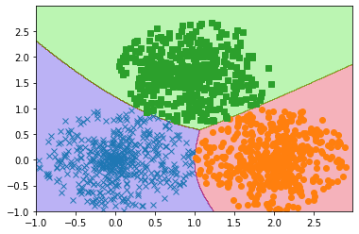
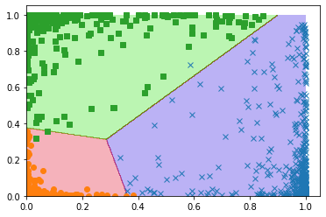
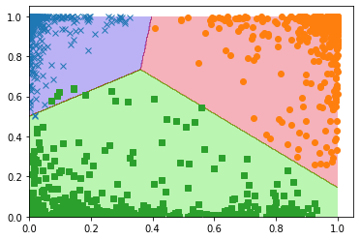






Neural Networks
Model
$$a^{\left[l\right]}=σ\left(z^{\left[l\right]}\right)$$
$$z^{\left[l\right]}={\left(w^{\left[l\right]}\right)}^{T}a^{\left[l−1\right]}+b^{\left[l\right]}$$
$$l=1,2,…,L−1$$
$$\hat{y}=a^{\left[L\right]}=softmax\left(z^{\left[L\right]}\right)$$
$$z^{\left[L\right]}={\left(w^{\left[L\right]}\right)}^{T}a^{\left[L−1\right]}+b^{\left[L\right]}$$
$$l=L$$

Slide 11
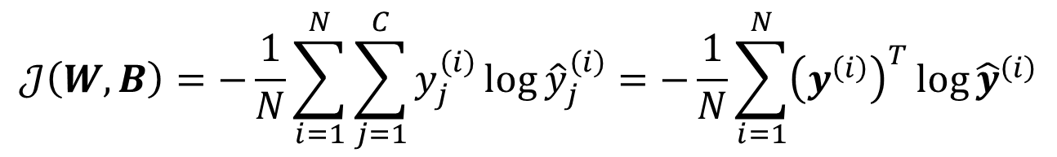
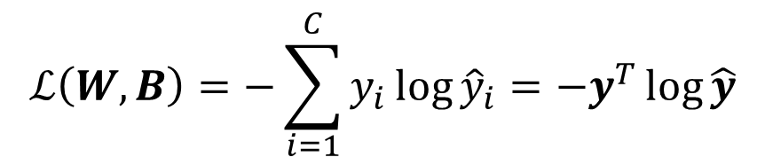
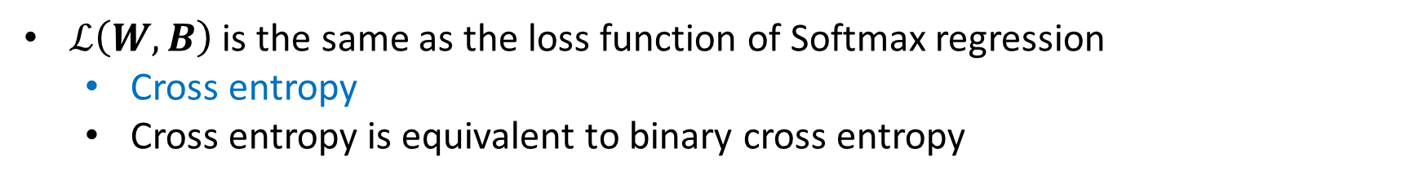
Cost Function
Loss Function
$$ℒ\left(W,B\right)=−\sum_{i=1}^{C}{y_{i}\log{{\hat{y}}_{i}}}=−y^{T}\log{\hat{y}}$$
Cost Function
$$𝒥\left(W,B\right)=−\frac{1}{N}\sum_{i=1}^{N}{\sum_{j=1}^{C}{y_{j}^{\left(i\right)}\log{{\hat{y}}_{j}^{\left(i\right)}}}}=−\frac{1}{N}\sum_{i=1}^{N}{{\left(y^{\left(i\right)}\right)}^{T}\log{{\hat{y}}^{\left(i\right)}}}$$
$ℒ\left(W,B\right)$ is the same as the loss function of Softmax regression
Cross entropy
Cross entropy is equivalent to binary cross entropy

Slide 12
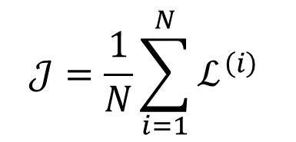
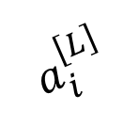
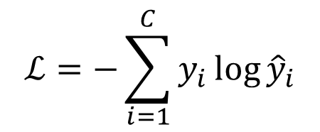
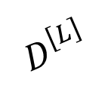
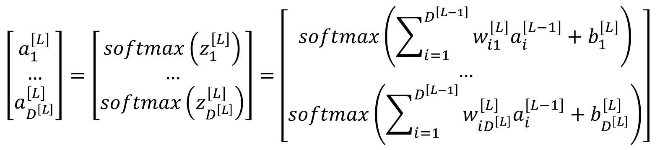
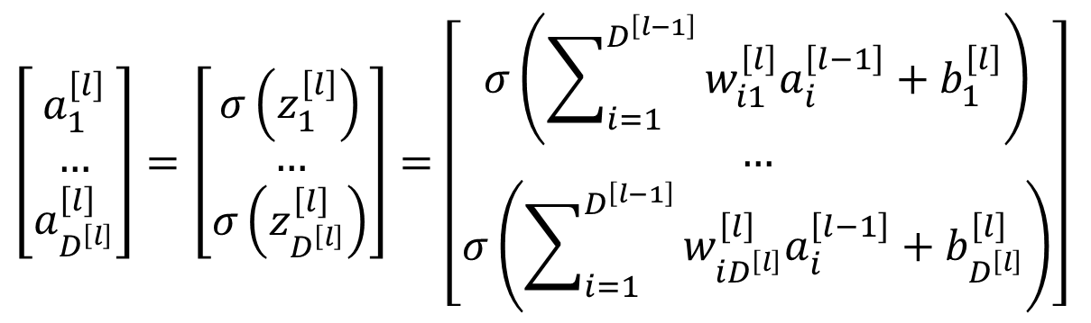
Gradient Descent
Model
$$\left[\begin{matrix}a_{1}^{\left[l\right]} \\ … \\ a_{D^{\left[l\right]}}^{\left[l\right]}\end{matrix}\right]=\left[\begin{matrix}σ\left(z_{1}^{\left[l\right]}\right) \\ … \\ σ\left(z_{D^{\left[l\right]}}^{\left[l\right]}\right)\end{matrix}\right]=\left[\begin{matrix}σ\left(\sum_{i=1}^{D^{\left[l−1\right]}}{w_{i1}^{\left[l\right]}a_{i}^{\left[l−1\right]}+b_{1}^{\left[l\right]}}\right) \\ … \\ σ\left(\sum_{i=1}^{D^{\left[l−1\right]}}{w_{iD^{\left[l\right]}}^{\left[l\right]}a_{i}^{\left[l−1\right]}+b_{D^{\left[l\right]}}^{\left[l\right]}}\right)\end{matrix}\right]$$
$$D^{\left[L\right]}$$
$$a_{i}^{\left[L\right]}$$
$$ℒ=−\sum_{i=1}^{C}{y_{i}\log{{\hat{y}}_{i}}}$$
$$\left[\begin{matrix}a_{1}^{\left[L\right]} \\ … \\ a_{D^{\left[L\right]}}^{\left[L\right]}\end{matrix}\right]=\left[\begin{matrix}softmax\left(z_{1}^{\left[L\right]}\right) \\ … \\ softmax\left(z_{D^{\left[L\right]}}^{\left[L\right]}\right)\end{matrix}\right]=\left[\begin{matrix}softmax\left(\sum_{i=1}^{D^{\left[L−1\right]}}{w_{i1}^{\left[L\right]}a_{i}^{\left[L−1\right]}+b_{1}^{\left[L\right]}}\right) \\ … \\ softmax\left(\sum_{i=1}^{D^{\left[L−1\right]}}{w_{iD^{\left[L\right]}}^{\left[L\right]}a_{i}^{\left[L−1\right]}+b_{D^{\left[L\right]}}^{\left[L\right]}}\right)\end{matrix}\right]$$
$$𝒥=\frac{1}{N}\sum_{i=1}^{N}{ℒ^{\left(i\right)}}$$

Slide 13

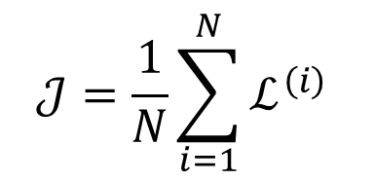




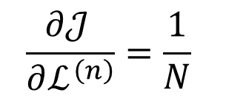
Back Propagation
$$ℒ^{\left(1\right)}$$
$$…$$
$$𝒥=\frac{1}{N}\sum_{i=1}^{N}{ℒ^{\left(i\right)}}$$
$$ℒ^{\left(i\right)}$$
$$𝒥$$
$$\frac{∂𝒥 }{∂ℒ^{\left(n\right)}}=\frac{1}{N}$$
$$…$$
$$ℒ^{\left(N\right)}$$

Slide 14
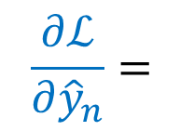
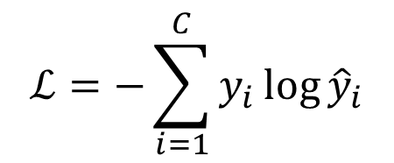




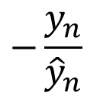
Back Propagation
$$ℒ=−\sum_{i=1}^{C}{y_{i}\log{{\hat{y}}_{i}}}$$
$${\hat{y}}_{1}$$
$$…$$
$$ℒ$$
$$\frac{∂ℒ}{∂{\hat{y}}_{n}}=$$
$$−\frac{y_{n}}{{\hat{y}}_{n}}$$
$${\hat{y}}_{C}$$

Slide 15

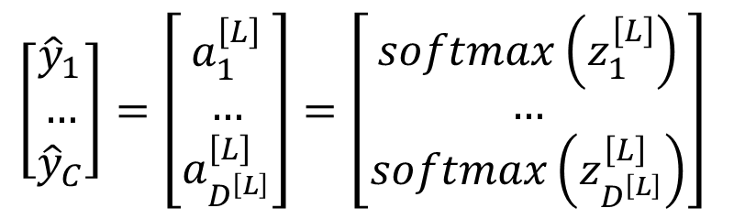


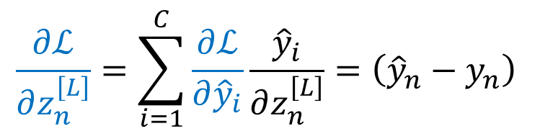

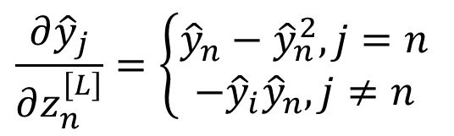

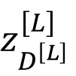
Back Propagation
$$\left[\begin{matrix}{\hat{y}}_{1} \\ … \\ {\hat{y}}_{C}\end{matrix}\right]=\left[\begin{matrix}a_{1}^{\left[L\right]} \\ … \\ a_{D^{\left[L\right]}}^{\left[L\right]}\end{matrix}\right]=\left[\begin{matrix}softmax\left(z_{1}^{\left[L\right]}\right) \\ … \\ softmax\left(z_{D^{\left[L\right]}}^{\left[L\right]}\right)\end{matrix}\right]$$
$$z_{1}^{\left[L\right]}$$
$${\hat{y}}_{1}$$
$$…$$
$$…$$
$$z_{D^{\left[L\right]}}^{\left[L\right]}$$
$${\hat{y}}_{C}$$
$$\frac{{∂\hat{y}}_{j}}{∂z_{n}^{\left[L\right]}}=\left\{\begin{aligned}{\hat{y}}_{n}−{\hat{y}}_{n}^{2},j=n \\ −{\hat{y}}_{i}{\hat{y}}_{n},j≠n\end{aligned}\right.$$
$$\frac{∂ℒ}{∂z_{n}^{\left[L\right]}}=\sum_{i=1}^{C}{\frac{∂ℒ}{∂{\hat{y}}_{i}}\frac{{\hat{y}}_{i}}{∂z_{n}^{\left[L\right]}}}=\left({\hat{y}}_{n}−y_{n}\right)$$

Slide 16

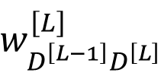
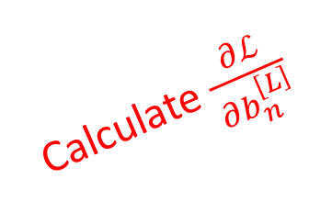


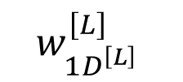
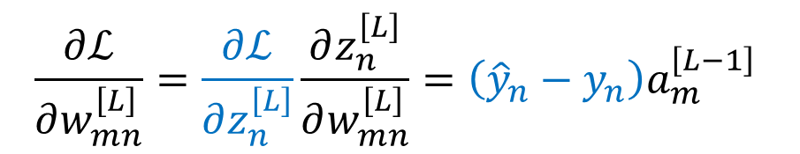
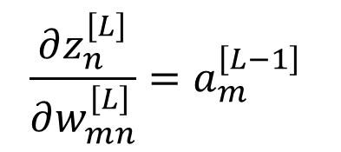

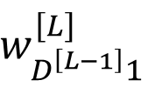



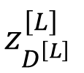
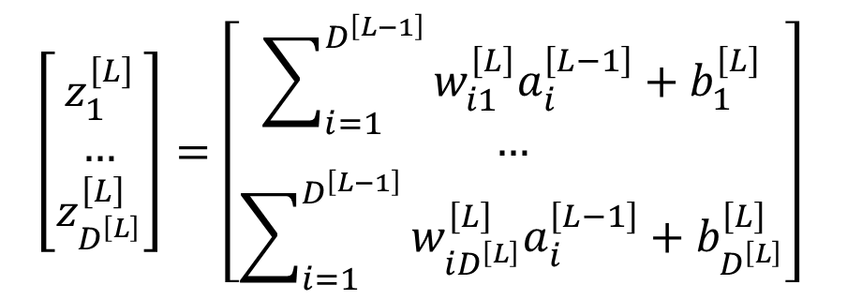

Back Propagation
$$w_{11}^{\left[L\right]}$$
$$\left[\begin{matrix}z_{1}^{\left[L\right]} \\ … \\ z_{D^{\left[L\right]}}^{\left[L\right]}\end{matrix}\right]=\left[\begin{matrix}\sum_{i=1}^{D^{\left[L−1\right]}}{w_{i1}^{\left[L\right]}a_{i}^{\left[L−1\right]}+b_{1}^{\left[L\right]}} \\ … \\ \sum_{i=1}^{D^{\left[L−1\right]}}{w_{iD^{\left[L\right]}}^{\left[L\right]}a_{i}^{\left[L−1\right]}+b_{D^{\left[L\right]}}^{\left[L\right]}}\end{matrix}\right]$$
$$…$$
$$z_{1}^{\left[L\right]}$$
$$w_{D^{\left[L−1\right]}1}^{\left[L\right]}$$
$$…$$
$$…$$
$$…$$
$$\frac{∂z_{n}^{\left[L\right]}}{∂w_{mn}^{\left[L\right]}}=a_{m}^{\left[L−1\right]}$$
$$…$$
Calculate $\frac{∂ℒ}{∂b_{n}^{\left[L\right]}}$
$$w_{1D^{\left[L\right]}}^{\left[L\right]}$$
$$\frac{∂ℒ}{∂w_{mn}^{\left[L\right]}}=\frac{∂ℒ}{∂z_{n}^{\left[L\right]}}\frac{∂z_{n}^{\left[L\right]}}{∂w_{mn}^{\left[L\right]}}=\left({\hat{y}}_{n}−y_{n}\right)a_{m}^{\left[L−1\right]}$$
$$…$$
$$z_{D^{\left[L\right]}}^{\left[L\right]}$$
$$w_{D^{\left[L−1\right]}D^{\left[L\right]}}^{\left[L\right]}$$

Slide 17
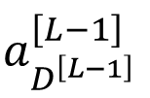





Back Propagation
$$\left[\begin{matrix}z_{1}^{\left[L\right]} \\ … \\ z_{D^{\left[L\right]}}^{\left[L\right]}\end{matrix}\right]=\left[\begin{matrix}\sum_{i=1}^{D^{\left[L−1\right]}}{w_{i1}^{\left[L\right]}a_{i}^{\left[L−1\right]}+b_{1}^{\left[L\right]}} \\ … \\ \sum_{i=1}^{D^{\left[L−1\right]}}{w_{iD^{\left[L\right]}}^{\left[L\right]}a_{i}^{\left[L−1\right]}+b_{D^{\left[L\right]}}^{\left[L\right]}}\end{matrix}\right]$$
$$a_{1}^{\left[L−1\right]}$$
$$z_{1}^{\left[L\right]}$$
$$…$$
$$…$$
$$a_{D^{\left[L−1\right]}}^{\left[L−1\right]}$$
$$z_{D^{\left[L\right]}}^{\left[L\right]}$$
$$\frac{∂z_{n}^{\left[L\right]}}{∂a_{m}^{\left[L−1\right]}}=w_{mn}^{\left[L\right]}$$
$$\frac{∂ℒ}{∂a_{m}^{\left[L−1\right]}}=\sum_{i=1}^{D^{\left[L\right]}}{\frac{∂ℒ}{∂z_{i}^{\left[L\right]}}\frac{∂z_{i}^{\left[L\right]}}{∂a_{m}^{\left[L−1\right]}}}=\sum_{i=1}^{D^{\left[L\right]}}{\left({\hat{y}}_{i}−y_{i}\right)w_{mi}^{\left[L\right]}}=\sum_{i=1}^{D^{\left[L\right]}}{\frac{∂ℒ}{∂z_{i}^{\left[L\right]}}w_{mi}^{\left[L\right]}}$$

Slide 18








Back Propagation
$$\left[\begin{matrix}a_{1}^{\left[l\right]} \\ … \\ a_{D^{\left[l\right]}}^{\left[l\right]}\end{matrix}\right]=\left[\begin{matrix}σ\left(z_{1}^{\left[l\right]}\right) \\ … \\ σ\left(z_{D^{\left[l\right]}}^{\left[l\right]}\right)\end{matrix}\right]$$
$$z_{1}^{\left[l\right]}$$
$$a_{1}^{\left[l\right]}$$
$$…$$
$$…$$
$$z_{D^{\left[l\right]}}^{\left[l\right]}$$
$$a_{D^{\left[l\right]}}^{\left[l\right]}$$
$$\frac{∂a_{n}^{\left[l\right]}}{∂z_{n}^{\left[l\right]}}=a_{n}^{\left[l\right]}−{\left(a_{n}^{\left[l\right]}\right)}^{2}$$
$$\frac{∂ℒ}{∂z_{n}^{\left[l\right]}}=\frac{∂ℒ}{∂a_{n}^{\left[l\right]}}\frac{∂a_{n}^{\left[l\right]}}{∂z_{n}^{\left[l\right]}}=\frac{∂ℒ}{∂a_{n}^{\left[l\right]}}\left[a_{n}^{\left[l\right]}−{\left(a_{n}^{\left[l\right]}\right)}^{2}\right]$$
$$=\left[a_{n}^{\left[l\right]}−{\left(a_{n}^{\left[l\right]}\right)}^{2}\right]\sum_{i=1}^{D^{\left[l+1\right]}}{\frac{∂ℒ}{∂z_{i}^{\left[l+1\right]}}w_{ni}^{\left[l+1\right]}}$$

Slide 19










Back Propagation
$$w_{11}^{\left[l\right]}$$
$$\left[\begin{matrix}z_{1}^{\left[l\right]} \\ … \\ z_{D^{\left[l\right]}}^{\left[l\right]}\end{matrix}\right]=\left[\begin{matrix}\sum_{i=1}^{D^{\left[l−1\right]}}{w_{i1}^{\left[l\right]}a_{i}^{\left[l−1\right]}+b_{1}^{\left[l\right]}} \\ … \\ \sum_{i=1}^{D^{\left[l−1\right]}}{w_{iD^{\left[l\right]}}^{\left[l\right]}a_{i}^{\left[l−1\right]}+b_{D^{\left[l\right]}}^{\left[l\right]}}\end{matrix}\right]$$
$$…$$
$$z_{1}^{\left[l\right]}$$
$$w_{D^{\left[l−1\right]}1}^{\left[l\right]}$$
$$…$$
$$…$$
$$…$$
$$\frac{∂z_{n}^{\left[l\right]}}{∂w_{mn}^{\left[l\right]}}=a_{m}^{\left[l−1\right]}$$
$$…$$
Calculate $\frac{∂ℒ}{∂b_{n}^{\left[l\right]}}$
$$w_{1D^{\left[l\right]}}^{\left[l\right]}$$
$$\frac{∂ℒ}{∂w_{mn}^{\left[l\right]}}=\frac{∂ℒ}{∂z_{n}^{\left[l\right]}}\frac{∂z_{n}^{\left[l\right]}}{∂w_{mn}^{\left[l\right]}}=\frac{∂ℒ}{∂z_{n}^{\left[l\right]}}a_{m}^{\left[l−1\right]}$$
$$…$$
$$z_{D^{\left[l\right]}}^{\left[l\right]}$$
$$w_{D^{\left[l−1\right]}D^{\left[l\right]}}^{\left[l\right]}$$

Slide 20






Back Propagation
$$\left[\begin{matrix}z_{1}^{\left[l\right]} \\ … \\ z_{D^{\left[l\right]}}^{\left[l\right]}\end{matrix}\right]=\left[\begin{matrix}\sum_{i=1}^{D^{\left[l−1\right]}}{w_{i1}^{\left[l\right]}a_{i}^{\left[l−1\right]}+b_{1}^{\left[l\right]}} \\ … \\ \sum_{i=1}^{D^{\left[l−1\right]}}{w_{iD^{\left[l\right]}}^{\left[l\right]}a_{i}^{\left[l−1\right]}+b_{D^{\left[l\right]}}^{\left[l\right]}}\end{matrix}\right]$$
$$a_{1}^{\left[l−1\right]}$$
$$z_{1}^{\left[l\right]}$$
$$…$$
$$…$$
$$a_{D^{\left[l−1\right]}}^{\left[l−1\right]}$$
$$z_{D^{\left[l\right]}}^{\left[l\right]}$$
$$\frac{∂z_{n}^{\left[l\right]}}{∂a_{m}^{\left[l−1\right]}}=w_{mn}^{\left[l\right]}$$
$$\frac{∂ℒ}{∂a_{m}^{\left[l−1\right]}}=\sum_{i=1}^{D^{\left[l\right]}}{\frac{∂ℒ}{∂z_{i}^{\left[l\right]}}\frac{∂z_{i}^{\left[l\right]}}{∂a_{m}^{\left[l−1\right]}}}=\sum_{i=1}^{D^{\left[l\right]}}{\frac{∂ℒ}{∂z_{i}^{\left[l\right]}}w_{mi}^{\left[l\right]}}$$

Slide 21


















Back Propagation
$$\frac{∂ℒ}{∂z_{n}^{\left[L\right]}}=a_{n}^{\left[L\right]}−y_{n}$$
$$ℒ=−y^{T}\log{\hat{y}}$$
$$\hat{y}=a^{\left[L\right]}=softmax\left(z^{\left[L\right]}\right)$$
$$z^{\left[L\right]}={\left(w^{\left[L\right]}\right)}^{T}a^{\left[L−1\right]}+b^{\left[L\right]}$$
…
$$z_{1}^{\left[L−1\right]}$$
$$a_{1}^{\left[L−1\right]}$$
$$z_{1}^{\left[L\right]}$$
$$a^{\left[L−1\right]}=σ\left(z^{\left[L−1\right]}\right)$$
$$\frac{∂ℒ}{∂w_{mn}^{\left[L\right]}}=\frac{∂ℒ}{∂z_{n}^{\left[L\right]}}\frac{∂z_{n}^{\left[L\right]}}{∂w_{mn}^{\left[L\right]}}=$$
…
$$z_{2}^{\left[L−1\right]}$$
$$a_{2}^{\left[L−1\right]}$$
$$z_{2}^{\left[L\right]}$$
$$\left(a_{n}^{\left[L\right]}−y_{n}\right)a_{m}^{\left[L−1\right]}$$
…
…
…
$$\frac{∂ℒ}{∂b_{n}^{\left[L\right]}}=\frac{∂ℒ}{∂z_{n}^{\left[L\right]}}\frac{∂z_{n}^{\left[L\right]}}{∂b_{n}^{\left[L\right]}}=$$
$$\left(a_{n}^{\left[L\right]}−y_{n}\right)$$
…
$$z_{D^{\left[L−1\right]}}^{\left[L−1\right]}$$
$$a_{D^{\left[L−1\right]}}^{\left[L−1\right]}$$
$$z_{D^{\left[L\right]}}^{\left[L\right]}$$

Slide 22





Back Propagation
$$\frac{∂ℒ}{∂z_{n}^{\left[L\right]}}=a_{n}^{\left[L\right]}−y_{n}$$
$$z^{\left[L\right]}={\left(w^{\left[L\right]}\right)}^{T}a^{\left[L−1\right]}+b^{\left[L\right]}$$
$$a^{\left[L−1\right]}=σ\left(z^{\left[L−1\right]}\right)$$
…
$$z_{1}^{\left[L−1\right]}$$
$$a_{1}^{\left[L−1\right]}$$
$$z_{1}^{\left[L\right]}$$
$$\left[a_{m}^{\left[L−1\right]}−{\left(a_{m}^{\left[L−1\right]}\right)}^{2}\right]\sum_{i=1}^{D^{\left[L\right]}}{\frac{∂ℒ}{∂z_{i}^{\left[L\right]}}w_{mi}^{\left[L\right]}}$$
$$\frac{∂ℒ}{∂z_{m}^{\left[L−1\right]}}=$$
…
$$z_{2}^{\left[L−1\right]}$$
$$a_{2}^{\left[L−1\right]}$$
$$z_{2}^{\left[L\right]}$$
…
…
…
…
$$z_{D^{\left[L−1\right]}}^{\left[L−1\right]}$$
$$a_{D^{\left[L−1\right]}}^{\left[L−1\right]}$$
$$z_{D^{\left[L\right]}}^{\left[L\right]}$$

Slide 23


















Back Propagation
$$\frac{∂ℒ}{∂z_{m}^{\left[L−1\right]}}=\left[a_{m}^{\left[L−1\right]}−{\left(a_{m}^{\left[L−1\right]}\right)}^{2}\right]\sum_{i=1}^{D^{\left[L\right]}}{\frac{∂ℒ}{∂z_{i}^{\left[L\right]}}w_{mi}^{\left[L\right]}}$$
$$a^{\left[l−1\right]}=σ\left(z^{\left[l−1\right]}\right)$$
$$z^{\left[l\right]}={\left(w^{\left[l\right]}\right)}^{T}a^{\left[l−1\right]}+b^{\left[l\right]}$$
…
$$z_{1}^{\left[l−1\right]}$$
$$a_{1}^{\left[l−1\right]}$$
$$z_{1}^{\left[l\right]}$$
$$\frac{∂ℒ}{∂w_{mn}^{\left[l\right]}}=\frac{∂ℒ}{∂z_{n}^{\left[l\right]}}\frac{∂z_{n}^{\left[l\right]}}{∂w_{mn}^{\left[l\right]}}=$$
$$\frac{∂ℒ}{∂z_{n}^{\left[l\right]}}a_{m}^{\left[l−1\right]}$$
…
$$z_{2}^{\left[l−1\right]}$$
$$a_{2}^{\left[l−1\right]}$$
$$z_{2}^{\left[l\right]}$$
$$\frac{∂ℒ}{∂b_{n}^{\left[l\right]}}=\frac{∂ℒ}{∂z_{n}^{\left[l\right]}}\frac{∂z_{n}^{\left[l\right]}}{∂b_{n}^{\left[l\right]}}=$$
$$\frac{∂ℒ}{∂z_{n}^{\left[l\right]}}$$
…
…
…
$$\left[a_{m}^{\left[l−1\right]}−{\left(a_{m}^{\left[l−1\right]}\right)}^{2}\right]\sum_{i=1}^{D^{\left[l\right]}}{\frac{∂ℒ}{∂z_{i}^{\left[l\right]}}w_{mi}^{\left[l\right]}}$$
$$\frac{∂ℒ}{∂z_{m}^{\left[l−1\right]}}=$$
…
$$z_{D^{\left[l−1\right]}}^{\left[l−1\right]}$$
$$a_{D^{\left[l−1\right]}}^{\left[l−1\right]}$$
$$z_{D^{\left[l\right]}}^{\left[l\right]}$$

Slide 24










Back Propagation
Back Propagation
$$\frac{∂ℒ}{∂z_{m}^{\left[L\right]}}=a_{m}^{\left[L\right]}−y_{m}$$
$$\frac{∂ℒ}{∂z_{m}^{\left[L−1\right]}}=a_{m}^{\left[L−1\right]}\left(1−a_{m}^{\left[L−1\right]}\right)\sum_{i=1}^{D^{\left[L\right]}}{\frac{∂ℒ}{∂z_{i}^{\left[L\right]}}w_{mi}^{\left[L\right]}}$$
$$\frac{∂ℒ}{∂w_{mn}^{\left[L\right]}}=\frac{∂ℒ}{∂z_{n}^{\left[L\right]}}a_{m}^{\left[L−1\right]}$$
$$\frac{∂ℒ}{∂b_{n}^{\left[L\right]}}=\frac{∂ℒ}{∂z_{n}^{\left[L\right]}}$$
$$\frac{∂ℒ}{∂z_{m}^{\left[L−2\right]}}=a_{m}^{\left[L−2\right]}\left(1−a_{m}^{\left[L−2\right]}\right)\sum_{i=1}^{D^{\left[L−1\right]}}{\frac{∂ℒ}{∂z_{i}^{\left[L−1\right]}}w_{mi}^{\left[L−1\right]}}$$
$$\frac{∂ℒ}{∂w_{mn}^{\left[L−1\right]}}=\frac{∂ℒ}{∂z_{n}^{\left[L−1\right]}}a_{m}^{\left[L−2\right]}$$
$$\frac{∂ℒ}{∂b_{n}^{\left[L−1\right]}}=\frac{∂ℒ}{∂z_{n}^{\left[L−1\right]}}$$
…
…
…
$$\frac{∂ℒ}{∂z_{m}^{\left[l−1\right]}}=a_{m}^{\left[l−1\right]}\left(1−a_{m}^{\left[l−1\right]}\right)\sum_{i=1}^{D^{\left[l\right]}}{\frac{∂ℒ}{∂z_{i}^{\left[l\right]}}w_{mi}^{\left[l\right]}}$$
$$\frac{∂ℒ}{∂w_{mn}^{\left[l\right]}}=\frac{∂ℒ}{∂z_{n}^{\left[l\right]}}a_{m}^{\left[l−1\right]}$$
$$\frac{∂ℒ}{∂b_{n}^{\left[l\right]}}=\frac{∂ℒ}{∂z_{n}^{\left[l\right]}}$$

Slide 25





Back Propagation
$$\frac{∂ℒ^{\left(i\right)}}{∂z_{m}^{\left[l\right]\left(i\right)}}=a_{m}^{\left[l\right]\left(i\right)}\left(1−a_{m}^{\left[l\right]\left(i\right)}\right)\sum_{i=1}^{D^{\left[l\right]}}{\frac{∂ℒ}{∂z_{i}^{\left[l+1\right]\left(i\right)}}w_{mi}^{\left[l+1\right]}}$$
$$\frac{∂ℒ^{\left(i\right)}}{∂z_{m}^{\left[L\right]\left(i\right)}}=a_{m}^{\left[L\right]\left(i\right)}−y_{m}^{(i)}$$
$$\frac{∂𝒥}{∂w_{mn}^{\left[l\right]}}=\sum_{i=1}^{N}{\frac{∂𝒥 }{∂ℒ^{\left(i\right)}}\frac{∂ℒ^{\left(i\right)}}{∂z_{n}^{\left[l\right]\left(i\right)}}\frac{∂z_{n}^{\left[l\right]\left(i\right)}}{∂w_{mn}^{\left[l\right]}}}$$
$$=\frac{1}{N}\sum_{i=1}^{N}{\frac{∂ℒ^{\left(i\right)}}{∂z_{n}^{\left[l\right]\left(i\right)}}a_{m}^{\left[l−1\right]\left(i\right)}}$$
Calculate $\frac{∂𝒥}{∂b_{n}^{\left[l\right]}}$

Slide 26



Back Propagation
$$\frac{∂𝓛}{∂z^{\left[l\right]}}=\left[\begin{matrix}\frac{∂ℒ^{\left(1\right)}}{∂z_{1}^{\left[l\right]\left(1\right)}} & … & \frac{∂ℒ^{\left(1\right)}}{∂z_{D^{\left[l\right]}}^{\left[l\right]\left(1\right)}} \\ … & … & … \\ \frac{∂ℒ^{\left(N\right)}}{∂z_{1}^{\left[l\right]\left(N\right)}} & … & \frac{∂ℒ^{\left(N\right)}}{∂z_{D^{\left[l\right]}}^{\left[l\right]\left(N\right)}}\end{matrix}\right]$$
$$\frac{∂𝒥}{∂w^{\left[l\right]}}=\left[\begin{matrix}\frac{1}{N}\sum_{i=1}^{N}{\frac{∂ℒ^{\left(i\right)}}{∂z_{1}^{\left[l\right]\left(i\right)}}a_{1}^{\left[l−1\right]\left(i\right)}} & … & \frac{1}{N}\sum_{i=1}^{N}{\frac{∂ℒ^{\left(i\right)}}{∂z_{D^{\left[l\right]}}^{\left[l\right]\left(i\right)}}a_{1}^{\left[l−1\right]\left(i\right)}} \\ … & … & … \\ \frac{1}{N}\sum_{i=1}^{N}{\frac{∂ℒ^{\left(i\right)}}{∂z_{1}^{\left[l\right]\left(i\right)}}a_{D^{\left[l−1\right]}}^{\left[l−1\right]\left(i\right)}} & … & \frac{1}{N}\sum_{i=1}^{N}{\frac{∂ℒ^{\left(i\right)}}{∂z_{D^{\left[l\right]}}^{\left[l\right]\left(i\right)}}a_{D^{\left[l−1\right]}}^{\left[l−1\right]\left(i\right)}}\end{matrix}\right]=\frac{1}{N}{\left(a^{\left[l−1\right]}\right)}^{T}\frac{∂𝓛}{∂z^{\left[l\right]}}$$
$$\frac{∂𝒥}{∂b^{\left[l\right]}}=\left[\begin{matrix}\frac{1}{N}\sum_{i=1}^{N}{\frac{∂ℒ^{\left(i\right)}}{∂z_{1}^{\left[l\right]\left(i\right)}}} & … & \frac{1}{N}\sum_{i=1}^{N}{\frac{∂ℒ^{\left(i\right)}}{∂z_{D^{\left[l\right]}}^{\left[l\right]\left(i\right)}}}\end{matrix}\right]$$

Slide 27


Back Propagation
$$\frac{∂𝓛}{∂z^{\left[L\right]}}=\left[\begin{matrix}\frac{∂ℒ^{\left(1\right)}}{∂z_{1}^{\left[L\right]\left(1\right)}} & … & \frac{∂ℒ^{\left(1\right)}}{∂z_{D^{\left[L\right]}}^{\left[L\right]\left(1\right)}} \\ … & … & … \\ \frac{∂ℒ^{\left(N\right)}}{∂z_{1}^{\left[L\right]\left(N\right)}} & … & \frac{∂ℒ^{\left(N\right)}}{∂z_{D^{\left[L\right]}}^{\left[L\right]\left(N\right)}}\end{matrix}\right]=a^{\left[L\right]}−y$$
$$\frac{∂𝓛}{∂z^{\left[l−1\right]}}=\left[\begin{matrix}a_{1}^{\left[l−1\right]\left(1\right)}\left(1−a_{1}^{\left[l−1\right]\left(1\right)}\right)\sum_{i=1}^{D^{\left[l\right]}}{\frac{∂ℒ^{\left(1\right)}}{∂z_{i}^{\left[l\right]\left(1\right)}}w_{1i}^{\left[l\right]}} & … & a_{D^{\left[l−1\right]}}^{\left[l−1\right]\left(1\right)}\left(1−a_{D^{\left[l−1\right]}}^{\left[l−1\right]\left(1\right)}\right)\sum_{i=1}^{D^{\left[l\right]}}{\frac{∂ℒ^{\left(1\right)}}{∂z_{i}^{\left[l\right]\left(1\right)}}w_{D^{\left[l−1\right]}i}^{\left[l\right]}} \\ … & … & … \\ a_{1}^{\left[l−1\right]\left(N\right)}\left(1−a_{1}^{\left[l−1\right]\left(N\right)}\right)\sum_{i=1}^{D^{\left[l\right]}}{\frac{∂ℒ^{\left(N\right)}}{∂z_{i}^{\left[l\right]\left(N\right)}}w_{1i}^{\left[l\right]}} & … & a_{D^{\left[l−1\right]}}^{\left[l−1\right]\left(N\right)}\left(1−a_{D^{\left[l−1\right]}}^{\left[l−1\right]\left(N\right)}\right)\sum_{i=1}^{D^{\left[l\right]}}{\frac{∂ℒ^{\left(N\right)}}{∂z_{i}^{\left[l\right]\left(N\right)}}w_{D^{\left[l−1\right]}i}^{\left[l\right]}}\end{matrix}\right]=a^{\left[l−1\right]}⊙\left(1−a^{\left[l−1\right]}\right)⊙\left(\frac{∂𝓛}{∂z^{\left[l\right]}}{\left(w^{\left[l\right]}\right)}^{T}\right)$$

Slide 28









Summary
Model
$$a^{\left[l\right]}=σ\left(z^{\left[l\right]}\right)$$
$$z^{\left[l\right]}={\left(w^{\left[l\right]}\right)}^{T}a^{\left[l−1\right]}+b^{\left[l\right]}$$
$$\hat{y}=a^{\left[L\right]}=softmax\left(z^{\left[L\right]}\right)$$
$$z^{\left[L\right]}={\left(w^{\left[L\right]}\right)}^{T}a^{\left[L−1\right]}+b^{\left[L\right]}$$
$$ℒ\left(W,B\right)=−y^{T}\log{\hat{y}}$$
Back Propagation
$$\frac{∂𝓛}{∂z^{\left[L\right]}}=a^{\left[L\right]}−y$$
$$\frac{∂𝓛}{∂z^{\left[l−1\right]}}=a^{\left[l−1\right]}⊙\left(1−a^{\left[l−1\right]}\right)⊙\left(\frac{∂𝓛}{∂z^{\left[l\right]}}{\left(w^{\left[l\right]}\right)}^{T}\right)$$
Gradient
$$\frac{∂𝒥}{∂b^{\left[l\right]}}=\left[\begin{matrix}\frac{1}{N}\sum_{i=1}^{N}{\frac{∂ℒ^{\left(i\right)}}{∂z_{1}^{\left[l\right]\left(i\right)}}} & … & \frac{1}{N}\sum_{i=1}^{N}{\frac{∂ℒ^{\left(i\right)}}{∂z_{D^{\left[l\right]}}^{\left[l\right]\left(i\right)}}}\end{matrix}\right]$$
$$\frac{∂𝒥}{∂w^{\left[l\right]}}=\frac{1}{N}{\left(a^{\left[l−1\right]}\right)}^{T}\frac{∂𝓛}{∂z^{\left[l\right]}}$$

Slide 29
Thank you！

